Slide 1

What are we remembering on Remembrance Day?
Sheffield Archives and Local Studies: History Key Stage 2 Unit 17
Notes:
Some key outcomes from this presentation:
By using these local resources pupils will explore:
Why we remember important occasions
The meaning of the poppy symbol
Dates and chronology
The significance of the 11th hour on the 11th day of the 11th month
How the war affected Sheffield and its people
Why people come to Sheffield from other countries
What sort of questions to ask about the past
Some other ideas for activities
Put all of the pictures and facts in this presentation in date order.
Discuss why it is important that Sheffield remembers the First World War, considering there are more recent ones.
Write a newspaper report on the peace celebrations. Who attended, what did they see, hear, smell and eat? Describe the scene.
Bring in to the classroom things that remind you of something or someone and / or things that people use to remember things, i.e. a photograph, a diary, sticky notes, a knotted handkerchief, a wall chart, a letter, a wedding DVD etc.
Visit a local war memorial and study the names and ages on it.

Slide 2
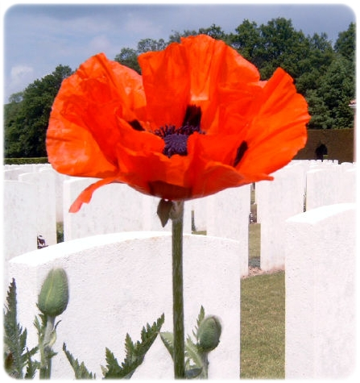
The Poppy
In early November each year people wear the red poppy flower on their clothes.
What are they remembering?

Slide 3
Remembering
The first poppies were worn after the end of World War One in 1918. This is a long time ago – almost 100 years. It can be difficult to remember things from long ago or even from yesterday – for instance, what did you have for breakfast last Tuesday?
Can you think of ways in which people remember important things?
Notes:
This question seeks to help the children understand that WWI was a long time ago – before most people alive today were born. We don’t remember it from being there and by using our own memory – we have to have something to remind us of it.
The poppy symbol reminds us about the war.
A diary, a knotted handkerchief, a birthday card, a note on a piece of paper, a photograph, our own memory are all ways in which we try and remember things.

Slide 4
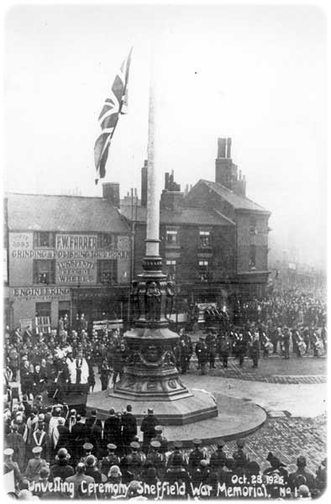
War Memorial 1
This is a picture of Sheffield’s main war memorial. It is outside the City Hall in the city centre. The picture was taken in 1925.
How many years after the end of the war is this?
Who do you think is watching this ceremony?
How do you think they may be feeling?
Notes:
As well as poppies a war memorial is used to remind us of the war. This slide, along with the next two illustrate that there are a lot of war memorials around.
The pupils are encouraged to work out that this memorial was erected seven years after the war.
In the crowd in this photographs there are likely to be men who fought in the war, mothers and fathers whose son was killed in the war, children whose father or older brothers may have been have been killed, people who were wounded, people who left their country to come to Britain (i.e. Belgians), people whose houses were bombed.
The people in the crowd will have strong memories because they experienced the events.
There are likely to be different feelings – sadness for those who were killed, relief that they themselves survived or that their son came home from the war safely. There may also be pride that Britain won. There may be strong feelings that there would be no more war because it had been so terrible and no-one would think another war would be a good idea.
www.picturesheffield.com ref. Y00578.

Slide 5
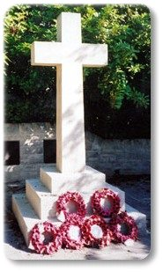
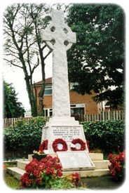
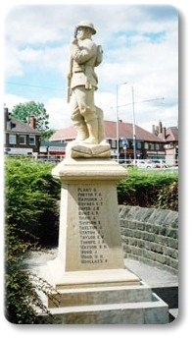
War Memorial 2
There are many war memorials in Sheffield. The ones pictured here are Grenoside, Totley and Gleadless
Is there one near where you live? There might even be one inside your school.
Notes:
This could be combined with a visit to a local war memorial – there are often memorials in the local churchyard or inside the church.
Occasionally there is one in a school or in a large factory or library.
Looking at the names on the memorial may reveal a family losing more than one person.
The memorial might record the age of the soldiers.
There may be references to later wars.
There may be surnames still common in the area today.
There may be a lot of names, illustrating the loss a small community experienced, compared to wars we fight today.
www.picturesheffield.com refs t03553, t03561 and u04730.

Slide 6
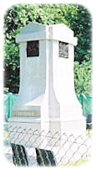
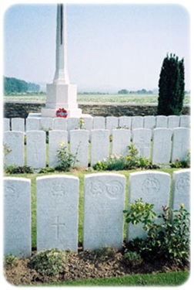
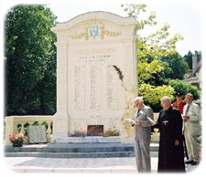
War Memorial 3
These are war cemeteries in Serre and Bapaume in France. They commemorate Sheffield soldiers.
Why are they in France and not Sheffield?
Notes:
This links to the poppy fields in France – hence the reason the poppy became the symbol used to remember the war.
The war took place in France and other parts of Europe.
Soldiers were sent abroad to fight – for most it was the first time they had left England.
Soldiers did not fight in Sheffield or another part of England.
Soldiers were buried in France – their bodies were not brought home. Their relatives could not normally afford to go to France to visit their grave. War memorials in England such as those on the previous slide were, in part, a substitute grave for relatives to visit and pay their respects.
This slide could be used with a map to see where Serre and Bapaume are in France and whether there are images of local poppy fields on the internet.
www.picturesheffield.com refs v02519 v02520 v2525.

Slide 7
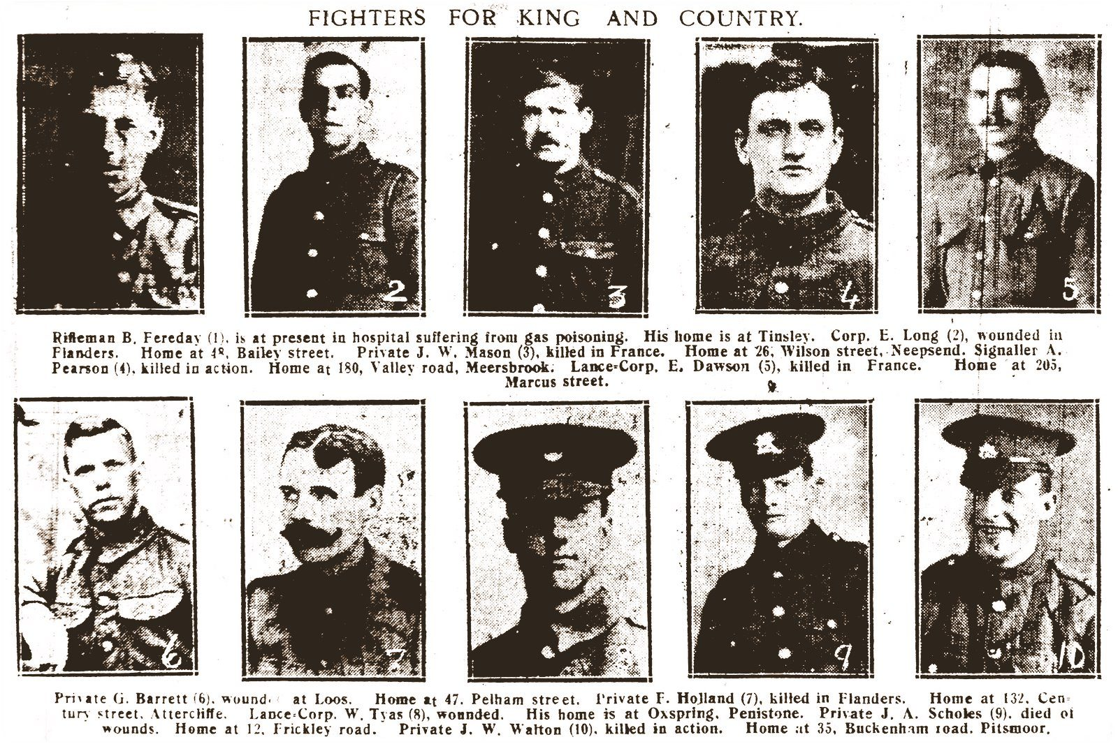
Casualties on the Battlefield
This is part of a Sheffield newspaper for November 1915. What can you find out about each soldier from reading this?
Notes:
These soldiers were killed or wounded in France.
At least one had been gassed.
They are from various parts of Sheffield.

Slide 8
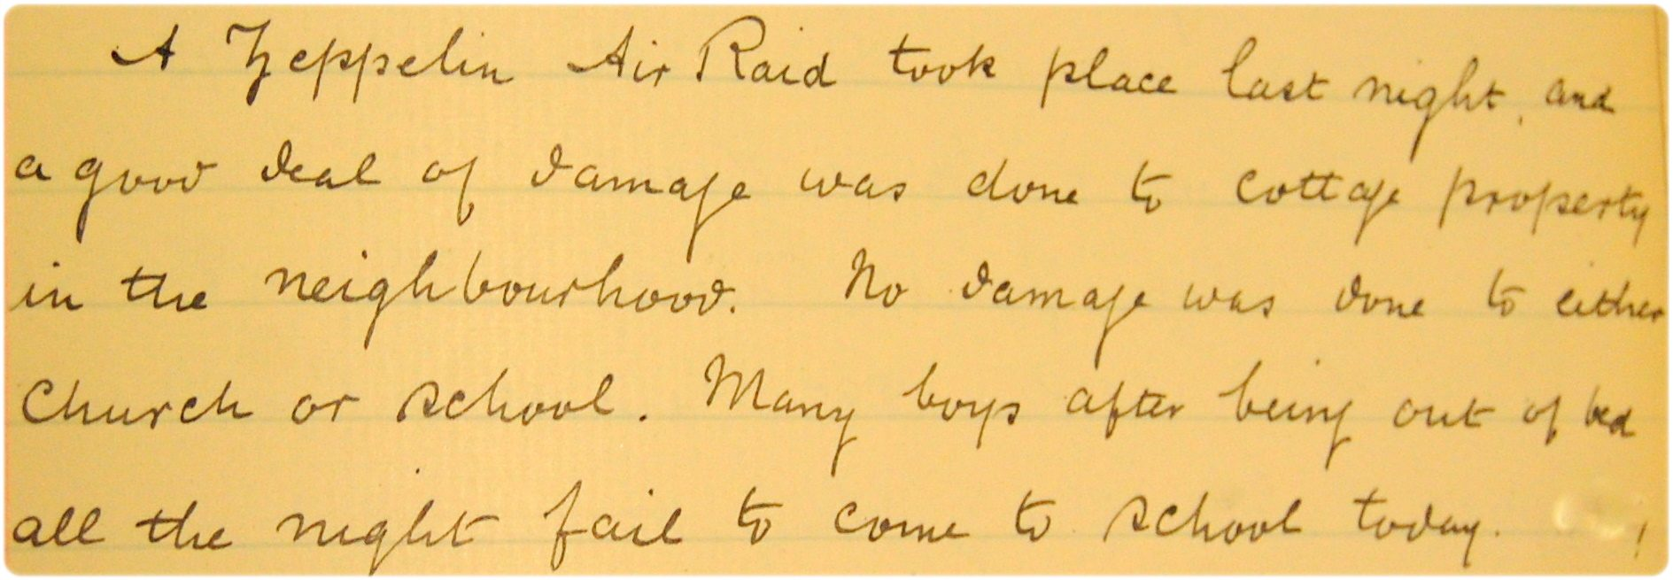
Casualties in Sheffield
It wasn’t just soldiers who were affected by war. Here is a report of a Zeppelin raid on Attercliffe in September 1916.
What is a Zeppelin?
What had the boys been doing?
Notes:
You could use Google Images to see a picture of a Zeppelin.
This was the first time a war affected Sheffield directly. Until the Zeppelins arrived fighting and bombing only took place on the battlefield between soldiers.
Sheffield is a long way from Germany – why was Sheffield a target? It was a main munitions production centre. Sheffield steel firms switched their production to armaments. Attercliffe was an industrial part of Sheffield.
The entry shown on the slide is taken from a head teacher’s log book or diary for 26 September 1916. It reads ‘A Zeppelin Air Raid took place last night and a good deal of damage was done to cottage property in the neighbourhood. No damage was done to either church or school. Many boys being out of the bed all the night fail to come to school today’.
Discussion could focus on how you would feel if a large zeppelin appeared in the sky over your house dropping bombs.
Image ref. Sheffield Archives CA35/767

Slide 9
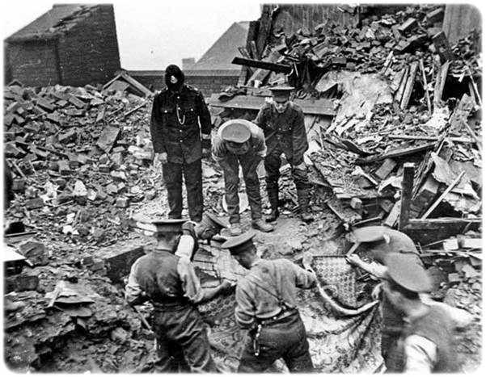
What are these men doing?
Notes:
Nos 24-28 Cossey Road, Burngreave, searching for survivors after the Zeppelin raid on Sheffield on the night of 25/26 September 1916.
www.picturesheffield.com ref s00146.

Slide 10
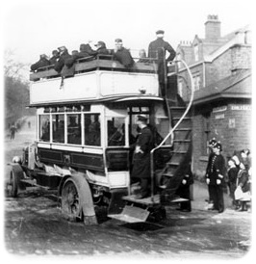
New Arrivals in Sheffield
Some people in Belgium and France left their homes to escape the fighting. They came to live in Sheffield.
Bus carrying Belgian casualties, Collegiate Crescent, Sheffield.
Notes:
How would you feel about leaving Sheffield and living somewhere else? What would you remember most about the city? Would you take anything with you to remind you of the city?
www.Picturesheffield.com ref: s00147

Slide 11
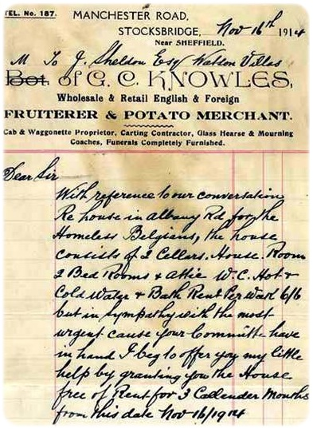
New Arrivals in Sheffield
This letter from 1914 records Mr Knowles letting people from Belgium live in his houses for free.
Today people still come to Sheffield from other parts of the world where there is fighting.
Can you think of any countries they may come from?
Notes:
Transcript of the letter:
“With reference to our conversation regarding [a] house in Albany Road for the Homeless Belgians, the house consists of 2 cellars, house, room, 2 Bed Rooms and Attic, W.C., hot and cold water and bath. Rent per week 2 shillings 6 pence [10 ½ p a week] but in sympathy with the most urgent cause your committee have in hand I beg to offer you my little help by granting you the house free of rent for 3 calendar months from this date, Nov 16th 1914.”
Discussion which would have to be sensitively held could focus on Somalia, Iraq, Afghanistan. There may be students in the class whose family did come to Sheffield to escape conflict in their country.
Image ref. Sheffield Archives CA68/11.

Slide 12
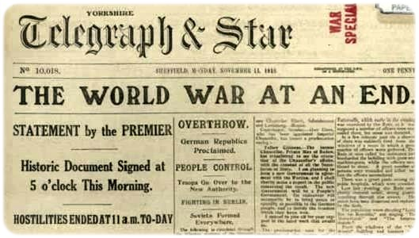
The End of the War
This is a page from the Yorkshire Telegraph dated 11 November 1918.
What is it telling us?
What time of day did the war end?
What day of the month and in which month?
Notes:
12
The term ‘armistice’ can be introduced with this slide.
The date of the newspaper is 11 November 1918.
Fighting was scheduled to stop at 11 o’clock that day on the 11th day, 11th month.
Today – almost 100 years later - we often have a minute’s silence at 11 o'clock on 11th November each year.

Slide 13
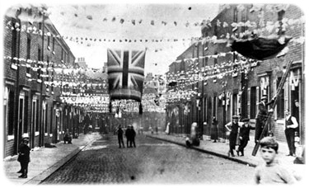
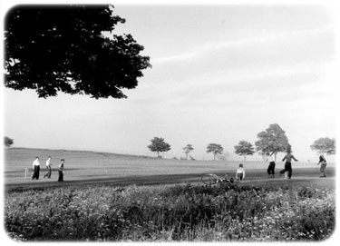
Peace Celebrations 1
When the war ended there was great celebration. There were parties in parks and streets.
Summer Street, Netherthorpe
High Hazels Park, Darnall
Notes:
Image refs. www.pictursheffield.com s00145 and v01869

Slide 14
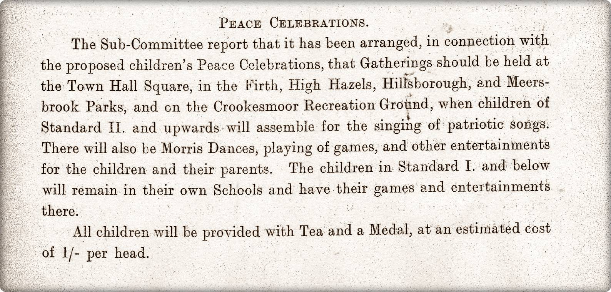
How did the children celebrate?
Notes:
Standard I is infants.
Standard II is junior.
1 shilling is 5 pence.
Sheffield City Council Education Committee minutes 1919. Sheffield Archives CA-EDU/17

Slide 15
Peace Celebration 2
The Lord Mayor was in charge of the celebrations. Look at the next two slides to see what celebrations took place.
Do you think everyone was happy?
How do you celebrate a special occasion?
Write down a few things you would do to celebrate that they wouldn’t have done in 1919.
Notes:
Other activities included: bands, bonfires, children’s parties, open air dancing, fireworks, a gun salute, medals, a military march past, treats for old people, teas for children, Morris dancing, a royal visit, search light displays, a holiday for working people.

Slide 16
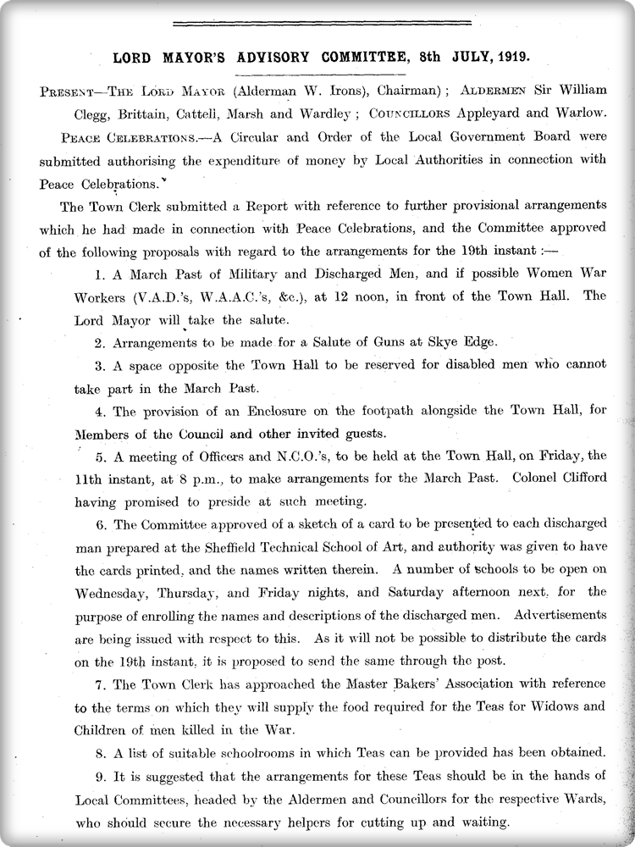
Notes:
Sheffield City Council minutes, 1919. ref. Sheffield Archives CA-MIN/54

Slide 17
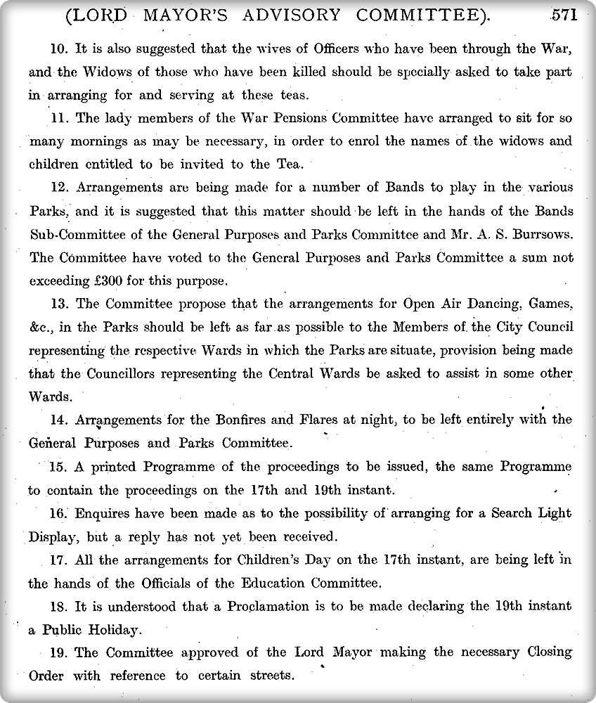
Notes:
Sheffield City Council minutes, 1919. ref. Sheffield Archives CA-MIN/54

Slide 18
After the War
World War One was described as ‘the war to end all wars’.
Have there been any wars since? Can you think of any other places where British men and women have gone to fight?

Slide 19
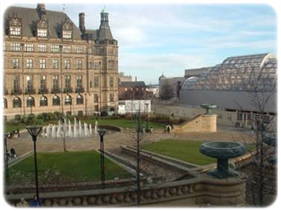
Into the 21st century
Do you recognise this view of Sheffield City Centre?
What is it called?
Why do you think it is called this?
Notes:
www.picturesheffield.com ref a00054

Slide 20
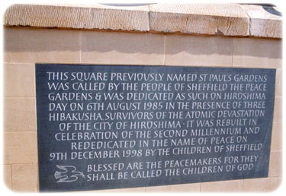
The need for memorials goes on…
What new memorials might be built in the future?
Notes:
The plaque shown in the slide explains how the Peace Gardens got its name.
There are memorials to the Falklands War (1982).
Here may be memorials to the war in Afghanistan and Iraq.
The National Memorial Arboretum in Staffordshire was opened in 1997. It has over 100 memorials of national significance.
www.picturesheffield.com ref. v00404)

Slide 21
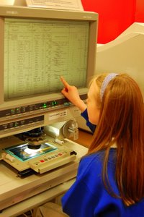
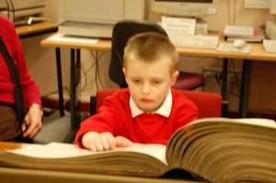
Sheffield Archives and Local Studies
If you prefer to use this presentation as a basis for a class visit to Archives and Local Studies or in a visit by us to your class please contact us. Students will have the opportunity to see and touch the original items.
We offer
Access to original primary source material from Tudor times through to the 21st century.
Class visits to the Central Library and to Sheffield Archives.
Visits to schools to deliver classroom sessions.
Introductory sessions for teaching staff.
Online PowerPoint lesson resources.
Focus Packs of colour facsimiles linked to the National Curriculum.
www.sheffield.gov.uk/archives

