Slide 1

North Area Community Plan 2023
● East Ecclesfield ● Stannington ● Stocksbridge and Upper Don ● West Ecclesfield

Slide 2

Local Area Committees (LACs) are a way for people to get involved in making a difference to their local communities. LACs have been given budgets to be used on issues and priorities that residents and communities have told us are important to them.
LACs are a chance for people to influence decision making, share their opinion and contribute to positive changes in their community. They are an opportunity for people to say what they would like to see improved in their area.
Further details about LACs can be found here – www.sheffield.gov.uk/home/your-city-council/local-area-committees

Slide 3
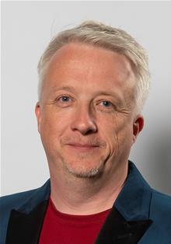





Who are the local area committee?
The Local Area Committee is made up of the twelve elected members of the four wards in the North LAC. This includes a Chair who is elected by members of the LAC and a Vice Chair.
East Ecclesfield Councillors | Stannington Councillors
Craig Gamble Pugh craig.gamblepugh@councillor. sheffield.gov.uk 07740 348273 | Penny Baker penny.baker@councillor. sheffield.gov.uk 0114 4185011 (Home)
Robert Reiss Robert.reiss@councillor. sheffield.gov.uk 07500 809758 | Vickie Priestley (Vice-chair) vickie.priestley@councillor. sheffield.gov.uk 0114 4490890 (Home)
Alan Woodcock alan.woodcock@councillor. sheffield.gov.uk 07766 541580 | Richard Williams richard.williams@councillor. sheffield.gov.uk 07766 539834

Slide 4




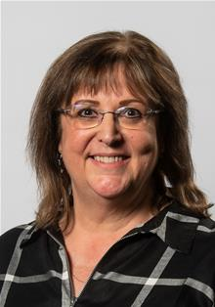

Who are the local area committee?
Stocksbridge and Upper Don Councillors | West Ecclesfield Councillors
Lewis Chinchen lewis.chinchen@councillor. sheffield.gov.uk 07766 540328 | Alan Hooper (Chair) alan.hooper@councillor. sheffield.gov.uk 0782 5195430
Julie Grocutt julie.grocutt@councillor. sheffield.gov.uk 07825195212 | Mike Levery mike.levery@councillor. sheffield.gov.uk 07776 142971
Janet Ridler janet.ridler@councillor. sheffield.gov.uk 07468 701684 | Ann Whitaker ann.whitaker@councillor. sheffield.gov.uk 07766 539882

Slide 5
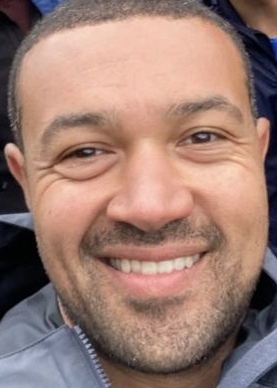
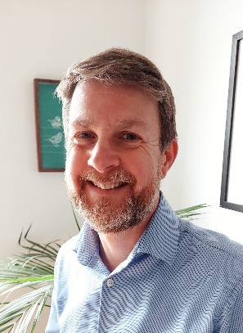
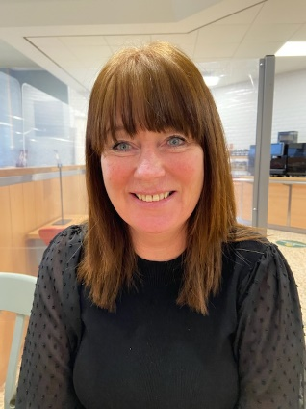
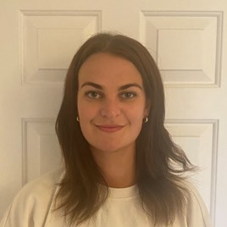
Staff team
Carl Mullooly– Head of Communities | Dave Luck – Community Services Manager | Teresa Bond – Community Services Officer | Isabel Male – LAC Officer
Carl.Mullooly @sheffield.gov.uk | David.luck@ sheffield.gov.uk | Teresa.bond@ sheffield.gov.uk | Isabel.male @sheffield.gov.uk

Slide 6
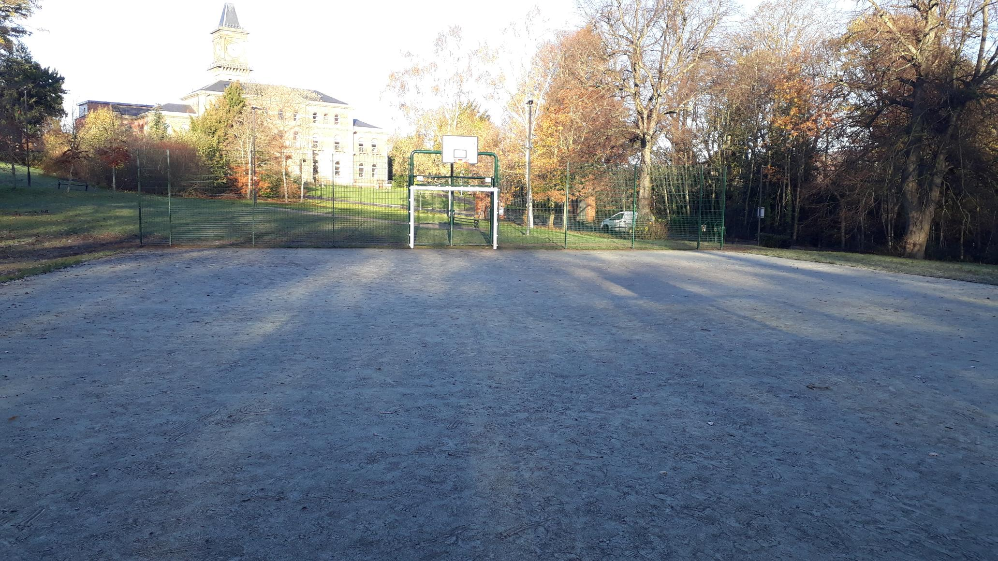
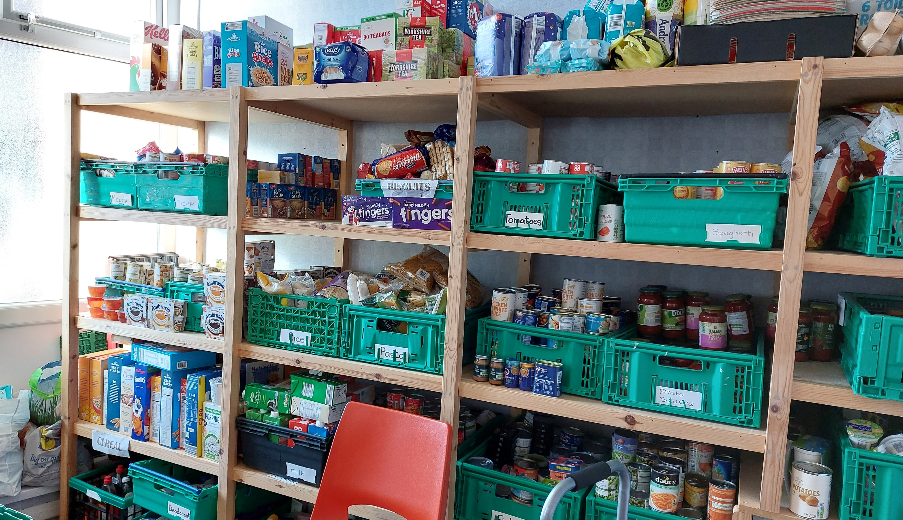
What has the LAC done since 2021?
Funded parks improvements to sites in Wadsley Park Village (pictured), Grenoside and Deepcar alongside Friends groups and Parish & Town Councils enabling £80k of improvements
Supported Food Banks and part-funded a new kitchen as part of the new Food Matters hub in Stocksbridge
Funded a new youth club in High Green
Delivered a series of practical Highways measures including a Vehicle Activated Sign per ward to highlight speeding

Slide 7
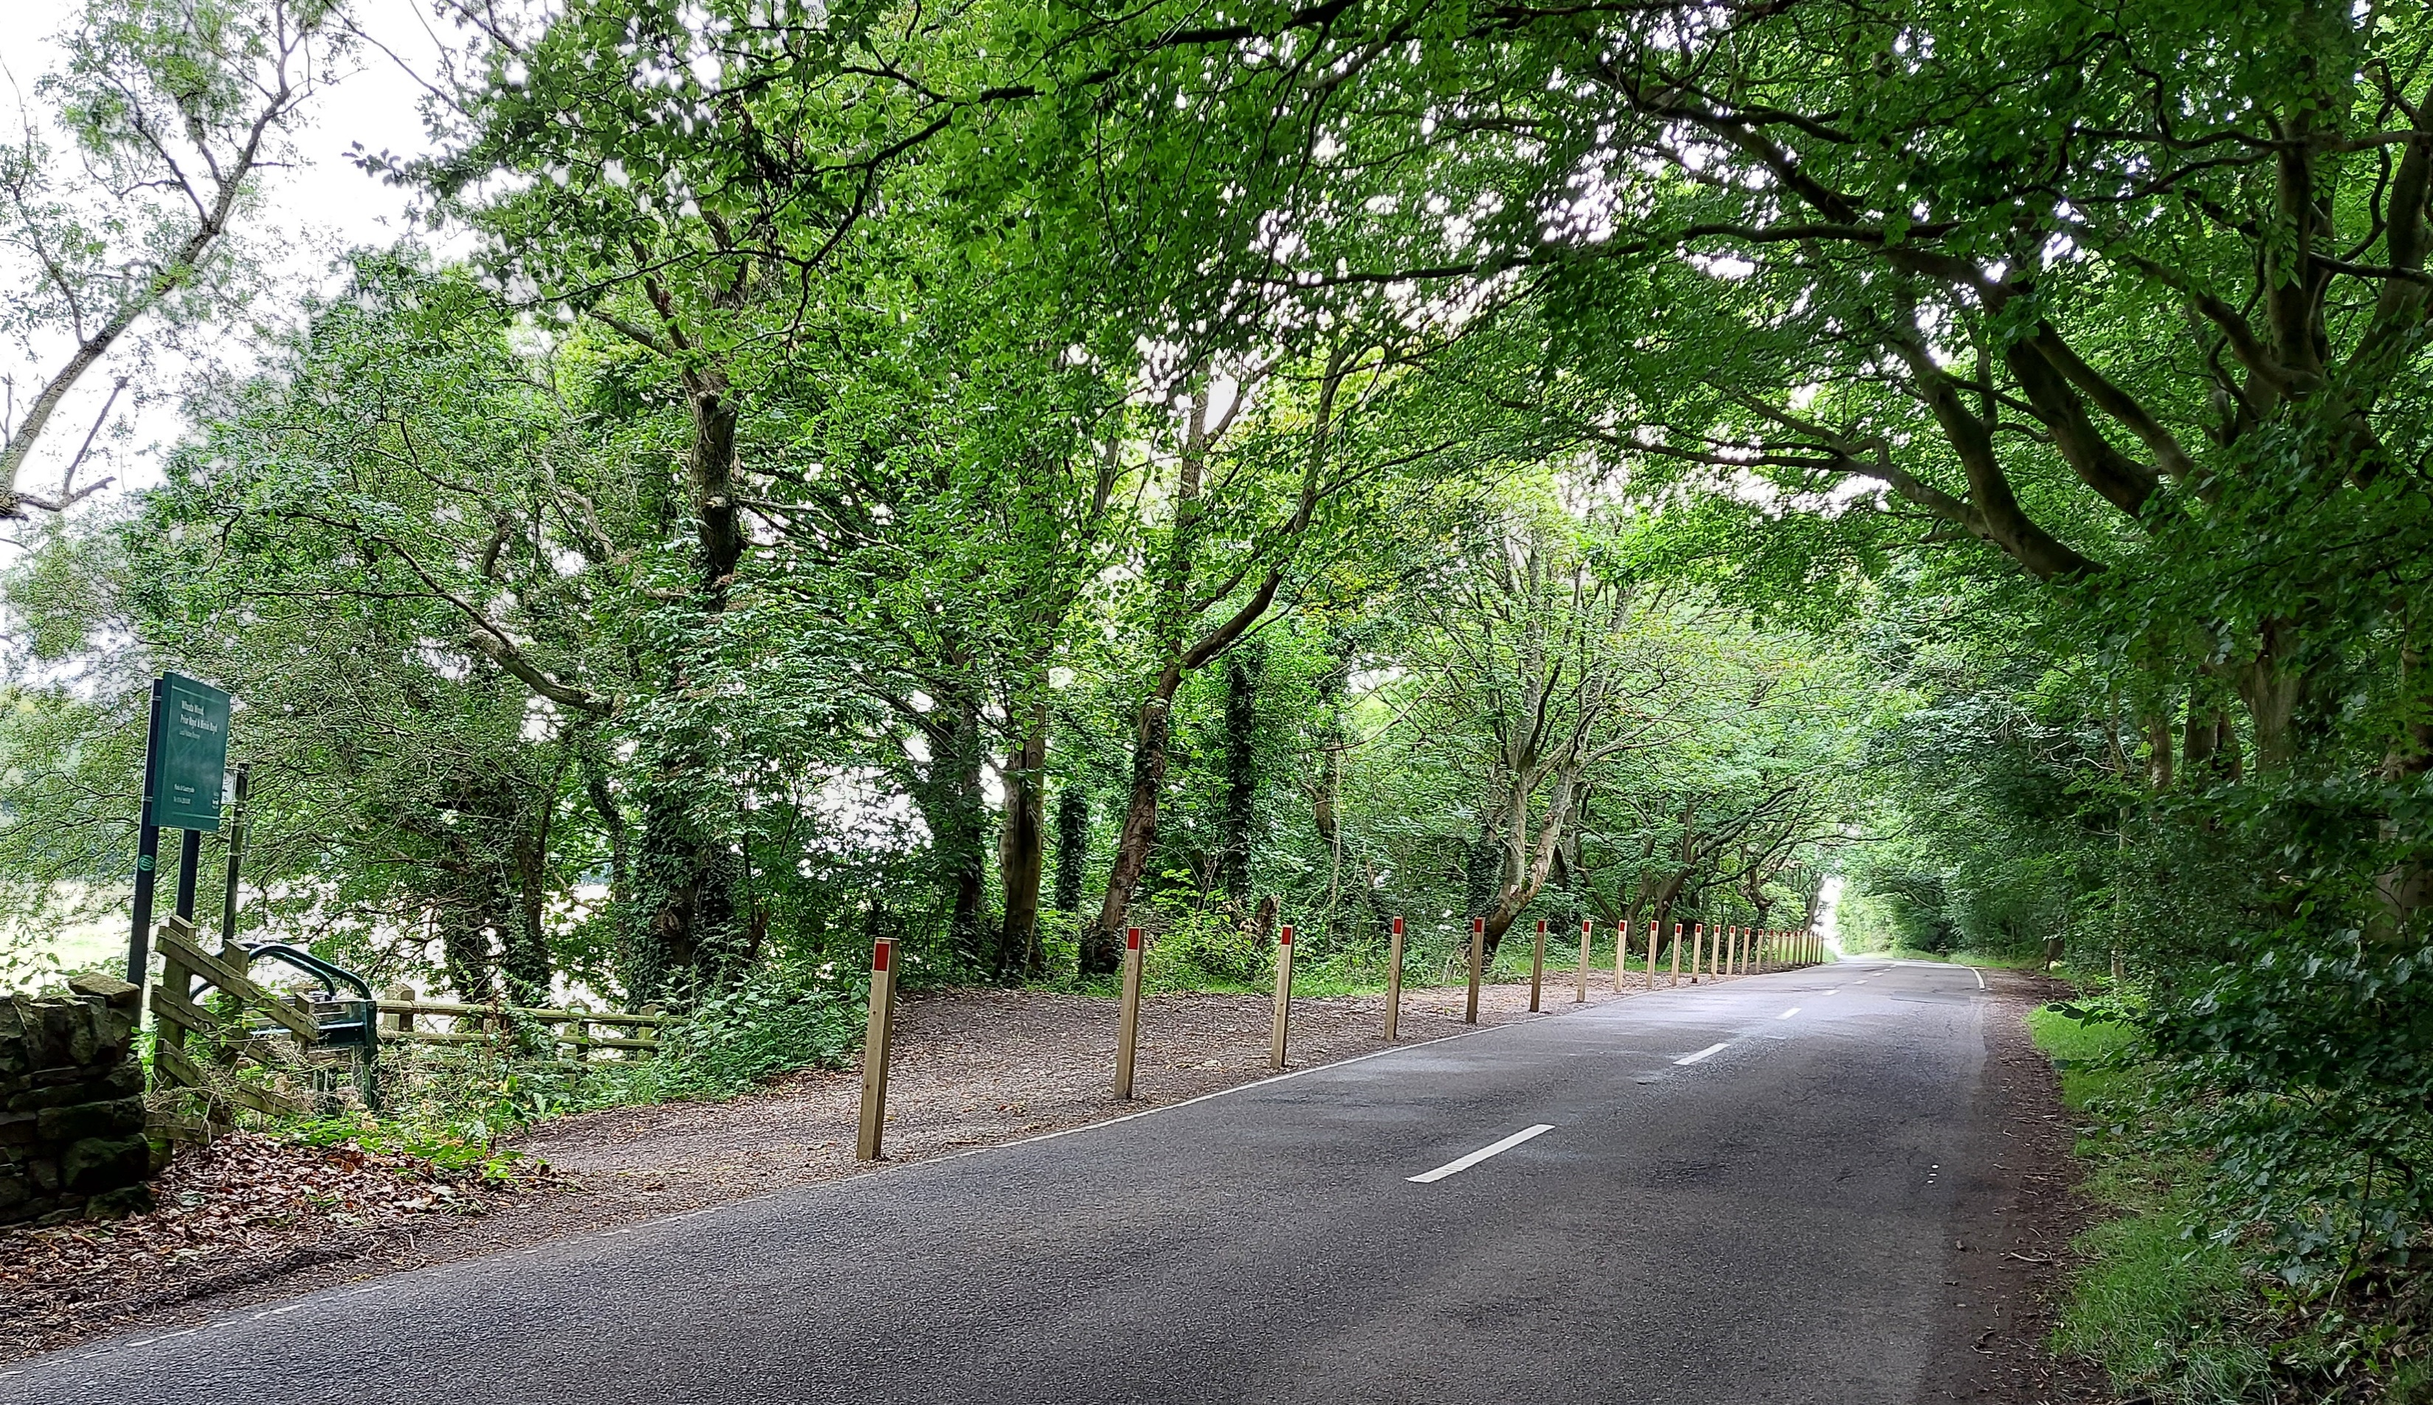
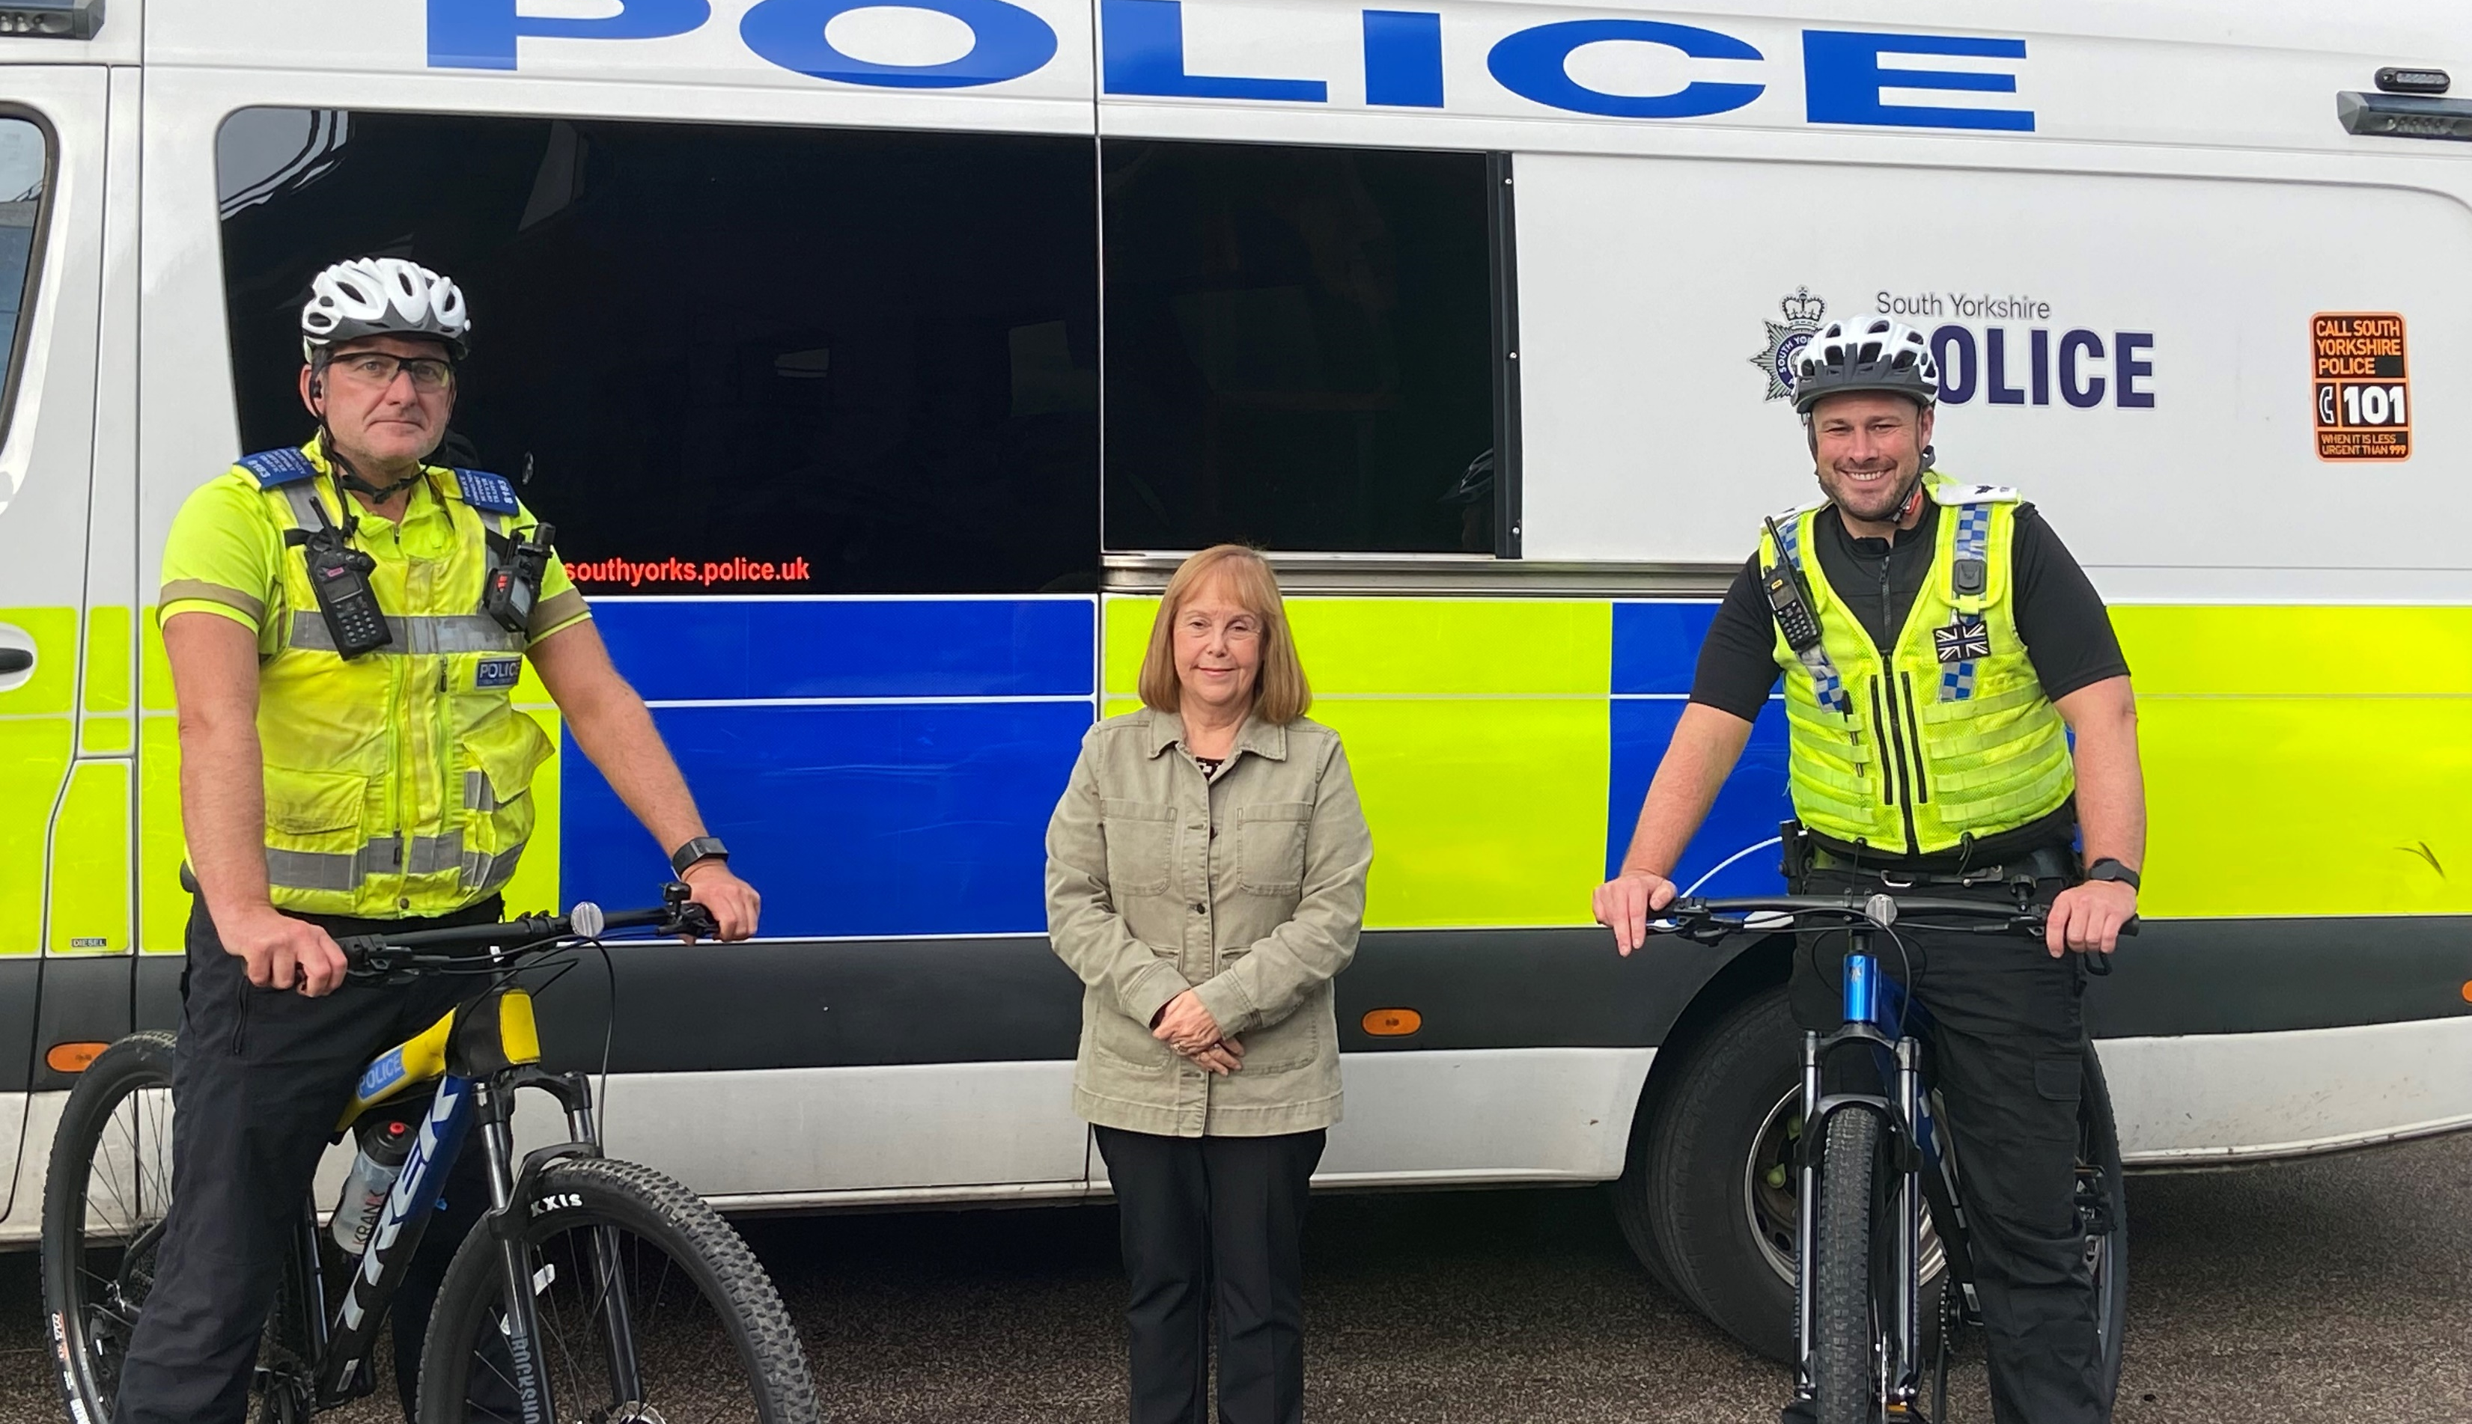
What has the LAC done since 2021?
Identified work to address fly tipping spots (pictured Woodhead Rd, Grenoside)
Funded local Police equipment
Supported a wide range of community projects including Jubilee and Coronation events
Supported the Stannington community during the gas flood crisis & organised a local Christmas cheer event

Slide 8








What we know about the North (Source: https:sheffield.communityinsight.org)
North has a population of 72,675
Age
0-15
17%
Working Age
60%
Age 65+
24%
White British 93.8%
Black, Asian, Ethnic Minority 4.4%
White (Non - British) 1.9%
Multi – Ethnic Households 4%
Ethnicity
11,424 People are living in deprivation
19% of people have no qualifications (compared with 18% across England)
20% have a limiting long-term illness. (compared with 17% across England)
Gender
48.9%
Male
51.1%
Female
Main Industry Sectors
1. Health & social care
2. Retail
3. Manufacturing
The average household income is £41,844
its not
Tenure
75% are Homeowners
13% Rent from the council
2% Rent from Housing Associations
8% are Private Renting

Slide 9
Features of the North
The North is a distinct part of Sheffield with large areas of countryside and communities with strong identities
The North is a relatively prosperous area but contains areas of deprivation and wider social needs, particularly regarding access to transport and services
The North has a stable population with a large proportion of older people and little ethnic diversity

Slide 10
Features of the North
Crime rates
The North has a rate of 65 crimes per 1000 people compared to 98 in England and 116 in Sheffield a whole
It’s rate of burglaries (10.3 per 1000 people) is slightly above the England rate (9.9) but below the Sheffield average (18.8)
Different age groups
24% of North residents are aged 65+ compared to 17% across Sheffield
16.5% are aged 0-15 in the North compared to 18% in Sheffield
6.4% of those aged 18-24 in the North are unemployed compared to 4% across Sheffield
2.7% of those of working age in the North are unemployed compared to 4.1% across Sheffield

Slide 11
Features of the North
Deprivation
16% of people in the North are living in an area of deprivation compared to 34% across Sheffield
The North contains two of the most 10% deprived areas nationally, both in High Green
The North scores highly on the community needs index, which measures community & civic infrastructure (high scores indicate level of need)
The North’s ‘community needs’ score is 106 (England 68, Sheffield 102)
The North’s ‘civic asset’ score is 35 (England 23, Sheffield 19)
The North’s ‘connectedness’ score is 56 (England 21, Sheffield 46)

Slide 12
LAC consultation
We launched a new consultation in June 2023 asking people how they felt about the North and what would make the biggest difference to it
This involved an on-line survey and face to face consultations across the North area
Through that we gathered views from 244 people
We also have the views of several consultation sessions with young people in the North and of a stakeholders meeting from those either leading areas of work or voluntary sector groups

Slide 13
What’s the best thing about your area?
45% of people surveyed said the countryside was the best thing about their neighbourhood
22.5% of people surveyed said the community was one of the best things about their neighbourhood
20% of people surveyed said that the local amenities are the best things in their area
* Percentages may not add up to 100, people say multiple things in their answers and some answers do not fall under the superordinate themes

Slide 14
What’s the worst thing about your area?
36% of people said that public transport was the worst thing about their area
26% said issues with the roads was the worst thing this is made up 9% issues with traffic, 12% condition of the roads (potholes etc) and 9% parking issues
15% of people stated crime and ASB was the worst thing about their area.
11% stated the amenities in their area was the worst thing.
4% worst thing was housing developments and a worry about infrastructure
* Percentages may not add up to 100, people say multiple things in their answers and some answers do not fall under the superordinate themes

Slide 15
What one thing would make the biggest difference in your area?
39% of people surveyed said improving public transport in their area would make the biggest difference.
31% of people surveyed mentioned an improvement to amenities in their local area would make the biggest difference, this was very broad and included better park equipment, more youth groups/ activities for children, improvement to roads and more.
14% of people surveyed said that dealing with crime/ increasing police presence was the main thing that would make the biggest difference in their area.
* Percentages may not add up to 100, people say multiple things in their answers and some answers do not fall under the superordinate themes

Slide 16
Ward summary – East Ecclesfield
Key headlines – people want to see better public transport and roads, crime tackled and better local amenities
People spoke us about:
Getting Chapeltown roundabouts resurfaced
Issues with speed and parking restrictions
More Police presence
Better access to public services & travel links
More activities for all ages with affordable things for families to do in the holidays
“Speed and parking restrictions
“Speed and

Slide 17
Ward summary - Stannington
Key headlines – people want to see better public transport, more Policing and better local amenities
People spoke to us about:
Having a reliable, affordable & punctual bus service, 7 days a week
More police patrols to address concerns about drugs and burglaries
More things on for families and better play facilities
Better phone signal

Slide 18
Ward summary – Stocksbridge and Upper Don
Key headlines – people want to see better public transport, increased Policing, better amenities and appropriate housing development
People spoke to us about:
Reductions in bus services, particularly the Supertram link – concerns that lack of transport reduces opportunities for young people
Concerns about ASB and speeding
More activities and upgraded facilities
Concerns about new housing developments on the green belt

Slide 19
Ward Summary – West Ecclesfield
Key headlines – people want better transport, improved roads and more Police presence
People spoke to us about:
Visible Policing to deal with petty crime & ASB
More reliable bus services to enable the elderly to stay active
Pothole repair & better street cleaning

Slide 20
Young People
Sessions were held with young people in Stannington and Stocksbridge by council youth workers.
Young people spoke positively about the area being friendly and enjoying its open spaces.
Issues voiced included:
Anxieties about cost of living and future opportunities
There not being enough to do, particularly that nothing is open late and transport is limited saying ‘we have to travel for everything’
Feeling young people are stereotyped and complained about
Wanting youth clubs to be open more
Concerns about litter, drug use and speeding

Slide 21
Stakeholders
An ideas session was held for people involved in voluntary groups and running services in the North. Comments & ideas included:
Need for vocational training & to build local connections with further education providers
Need for mentors for young people
Need for support for isolated young adults including local drug support
Ideas around skills sharing & tool banks

Slide 22
Approach
The North faces entrenched issues, particularly around isolation and facilities
There is a disparity between those with the means to function independently and those without them – the North is a great place to live but can be a hard place to fall behind and an easy place for needs to be missed
There is a sense of the North being disconnected from the centre of Sheffield and in some people’s eyes of having been forgotten
It is proposed that this plan seeks to balance clear priorities, quick wins where achievable but also a focus on longer term goals
We will continue to work by developing creative partnerships across the area
We will look for opportunities to engage more local people and better communicate the work that we are doing

Slide 23
Priorities
Improving local transport through practical Highways improvements and promoting better public transport
Improving community safety
Improving community life

Slide 24
Goals
Long term goals:
The North is a connected place where people can access what they need to play an active part in their community
The North is a safe place to live in and travel around
The North is an attractive place with good facilities

Slide 25
Our goal is that the North is a connected place where people can access what they need to play an active part in their community
We will:
- Have a continued focus on those in greatest need
Explore work to combat social isolation across communities and ages including working with young adults
Support development of increased & varied youth activity
Explore scope for new vocational opportunities for young people & adults
Look for opportunities to address digital exclusion including support for people to get online & Broadband cold spots
Carry out an asset mapping exercise in East Ecclesfield
Promote the new North information guide and new ‘Greatest Need’ and ‘Big idea’ funds

Slide 26
Our goal is that the North is a safe place to live in and travel around
We will:
- Work to highlight transport needs across the North
Support initiatives to develop community transport
Deliver a series of pedestrian improvements across the North
Launch new Community Action Groups to address anti-social behaviour alongside partners
Look at opportunities to develop new work around parking & speeding, particularly around schools
Promote routes to report crime & promote accurate perceptions of the risk of crime

Slide 27
Our goal is that the North is an attractive place with good facilities
We will:
Support work to improve parks and open space alongside Friends of groups
Support the development & improvement of Community buildings & spaces such as Stannington Pavilion
Promote and develop accessible community facilities
Support ERF initiatives to improve local High streets
Explore further opportunities to tackle litter & fly tipping hot spots
Continue to support local community groups and initiatives

